Slide 1
Accounting for Inventory and Cost of Goods Sold : 10 marks numerical

Slide 2
Inventory
The term ‘inventory’ is a stock of goods maintained for specific purpose. The stock of goods is either sold directly without further processing or used as input for the production process.

Slide 3
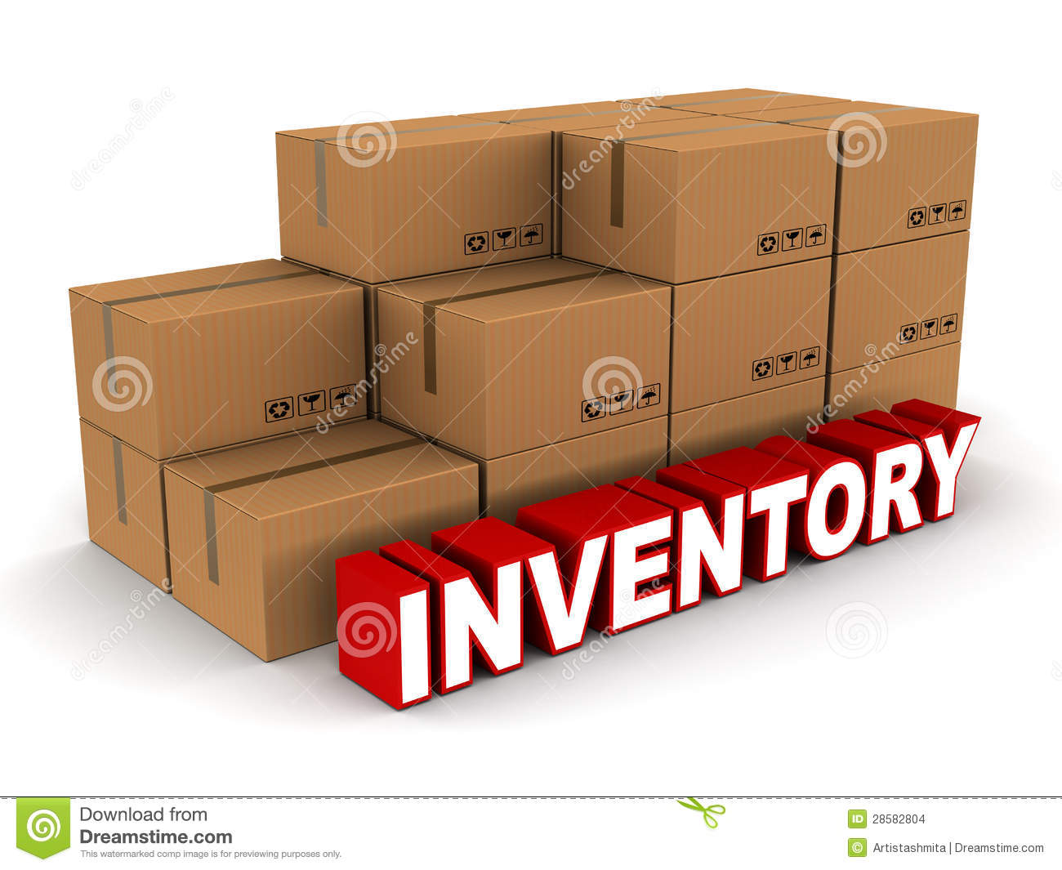

Slide 4
Cost of inventory
Cost of raw material
Cost of work in progress
Cost of finished goods

Slide 5
Cost of goods sold model
Opening stock + Net Purchases + Direct expenses – Closing Stock

Slide 6
Inventory system
1. Periodic Inventory system (Imp.)
2. Perpetual Inventory system

Slide 7
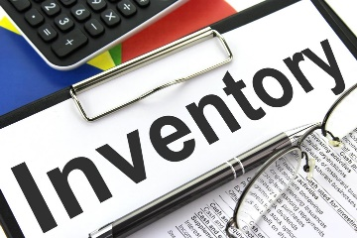

Techniques of inventory system
PERPETUAL
PERIODIC
UPDATES INVENTORY ACCOUNT AT REGULAR INTERVALS TRIGGERED BY A PHYSICAL INVENTORY COUNT
CONTINOUSLY UPDATES INVENTORY ACCOUNT AS GOODS ARE BOUGHT & SOLD ON A UNIT-BY-UNIT BASIS
This Photo by Unknown Author is licensed under CC BY-SA

Slide 8
Inventory costing method with periodic system (Without Store Ledger)
FIFO
LIFO
WEIGHTED AVERAGE / WA Cost
SPECIFIC IDENTIFICATION
1, 2 and 3- VVI.
To be find out Cost of Goods Sold (COGS) and Cost of Ending Inventory

Slide 9
2 reasons to use Periodic Inventory System
1. Many small companies use periodic rather than perpetual system
2. Very few companies use perpetual FIFO, LIFO or average cost to cost their inventory and related cost of goods sold.

Slide 10
Perpetual Inventory System
Methods
FIFO, LIFO and Moving Average method
To be find out COGS and Cost of Ending Inventory
(through Store Ledger)

Slide 11
Common Topics for both system

Slide 12
Inventory Valuation and Income statement
Particulars | FIFO | LIFO
Sales Revenue Less, Cost of goods sold
Gross Profit Less, Operating expense
Net income before tax Less, Tax expense
Net Income after Tax

Slide 13
Tax advantages:
At time of inflationary:
Price is rising situation: COGS is high it means profit is low so tax is save and company pays least amount of tax under LIFO Method.
Reverse in FIFO Method
Price is decreasing situation ie. Called deflation period
Under FIFO Method, COGS is high it means profit is low so company pays least amount of tax.

Slide 14
Inventory Estimation
2 methods
A. Retail Inventory method
Particulars | Cost | Retail (Sales)
Beg. Inv Add, Net Purchase | 50,000 2,00,000 | 80,000 3,20,000
Total goods available for sales Less, Sales Estimated Ending Inventory | 2,50,000 ? ? | 4,00,000 3,00,000 1,00,000

Slide 15
Calculate the amount of Inventory lost, if inventory was safe Rs 20,000
Cost to retail price ratio = Cost/Retail price = 2,50,000/4,00,000
= 62.5%
Now, Estimated Ending Inventory at cost = Estimated Ending Inventory at retail x cost to retail ratio
Rs 1,00,000 x 62.5% = Rs 62,500
Inventory Lost= Rs 62,500 – Rs 20,000 = Rs 42,500
COGS = Sales x Ratio = 3,00,000x 62.5%
= Rs 1,87,500

Slide 16
B. Gross Profit method
 | Rs | Rs
Beg. Inventory Add, Purchase |  | 20,000 80,000
COG available for sales Less, Estimated COGS: Sales Less, GP (40%) Estimated COGS Estimated E.I. | 1,50,000 60,000 | 1,00,000 90,000 10,000

Slide 17
Estimated Inventory lost = Estimated value of ending inventory- amount of inventory safe
= 10,000 – 2,000 = 8,000
Journal
Date | Particulars | PR | Debit | Credit
 | Insurance Company Dr Loss on explosion Dr Inventory (To record for insurance claimed and loss for inventory) |  | 5,000 3,000 | 8,000

Slide 18
Analyzing the Management of Inventory
Ratios:
Inventory Turn Over Ratio (ITR) = COGS/ Average Inventory
A.I. = (beg inv. + end. Inv)/2
No. of Days sales in inventory = No. of Days in a year/ ITR
G.P. Ratio = (G.P./Sales) x 100

Slide 19
Important theory: Assignment
Different between perpetual and periodic inventory system.
Write about retail inventory estimation method.
Explain the gross profit method of estimating inventories. In what types of situations is this technique likely to be useful?
(Hint: Periodic and if prepare Financial Statements monthly or quarterly)
4. What is inventory? Explain the inventory costing methods.
5. Explain the cost of goods sold model

